Slide 1
Dusk of Mankind
Moin Uddin huq; 1620005042,Abdullahel Kafi; 1620022042, Tanjila Islam Ritu;1811017642 , Tanzila Islam; 1811027642 .

Slide 2
Game concept
Dusk on mankind is a game where the sole objective is to survive the wave of enemies that are attacking the player.

Slide 3
Game loop
Start Screen
Player Spawn
Zombie spawn
Wave Start
Player Dies
Kill all zombies
Next wave start

Slide 4
Story & Progression

Slide 5
Map Location
Train Station
This is the starting location. This map is located in Bali. This is where the journey of Alex begins.
Outskirts of Afghanistan
In this map Alex is making his way towards Afghanistan . This map is located in the border between Pakistan and Afghanistan.
Granitsa Ukrainy
At the last leg of Alex’s Journey. Located in the border between Ukraine and Kazakhstan.

Slide 6
Protagonist’s Story
there our protagonists name is ”Alex”. Alex is a 34 years old Male from the USA. He was traveling to South East Asia Countries when the zombie outbreak hit, he is stuck here since. As the only way to reach his family to go to Ukraine a catch a plane from Ukraine to USA. He is making his way towards Ukraine to get a chance of reuniting with his family . Alex had some firearm training when he served in the military.

Slide 7
World Backstory
After those events Russia, USA, and all other ocean locked countries are completely safe from the infection . USA due to locking of there borders and Russians due to there cure. Russia now supplies the whole world with the cure at a slow pace due to this price has skyrocketed. Because of this Russia now sits at the top of all countries in terms of power and some believe that zeta variant was designed by the Russians themselves. Ukraine is also producing there own cure with the help of the Russian govt.Ukraine is the last reaming country to accept outsiders coming to there border they also broadcast this , so naturally everyone is making there way towards Ukraine. we pick up on our protagonist Alex who is making his way towards Ukraine. He is almost there as he has only 4 cites left to go. we accompany Alex on his last leg of the journey .

Slide 8
Progression
The game will progress in waves.
There are four levels
Every level contains four waves
Objective is to kill all the zombies thus clearing all the waves.

Slide 9
Tech

Slide 10
Tech
Engine
Assets
Animation
This game is based on Unreal Engine 4. We are also using blueprints feature.
Our environtmental assets are from quixel bridge. We are using some from Epic Marketplace too.
We are using some animations from Epic marketplace but mostly from Adobe Mixamo.

Slide 11
Progress Till NOw

Slide 12
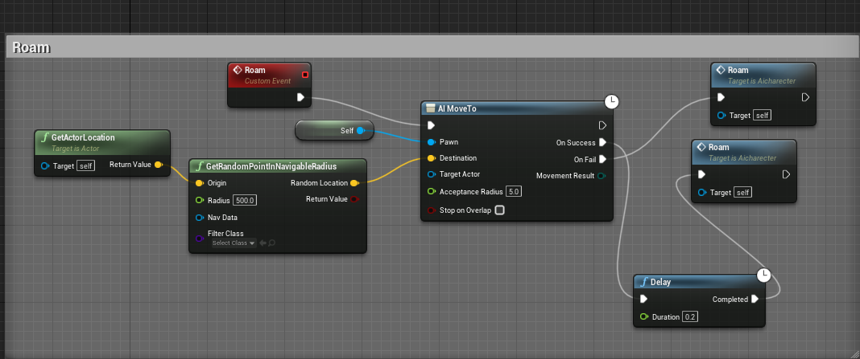
Enemy ai (Roaming)

Slide 13
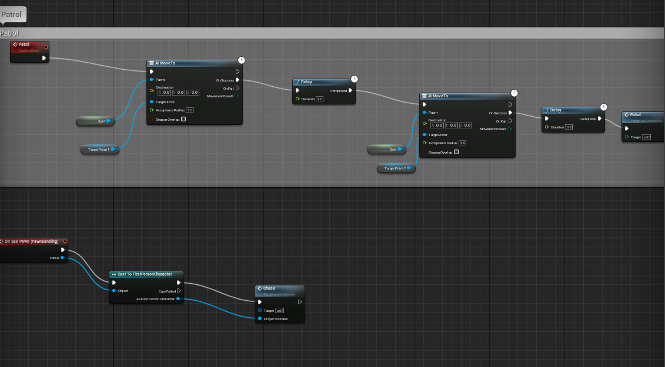
Enemy ai (Patrolling perimeter)

Slide 14
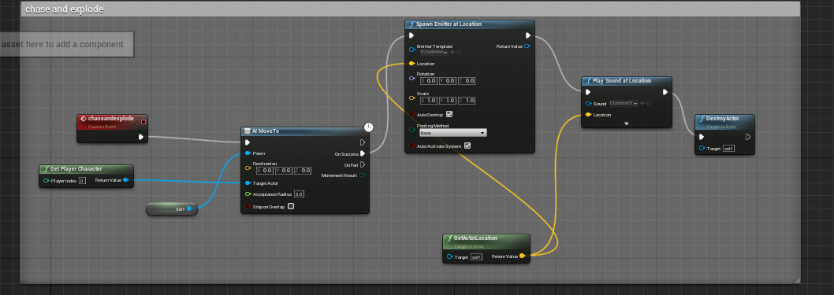
Enemy ai (chase and explode)

Slide 15
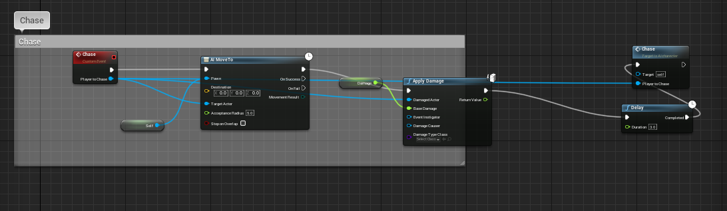
Enemy ai (chase and follow)

Slide 16
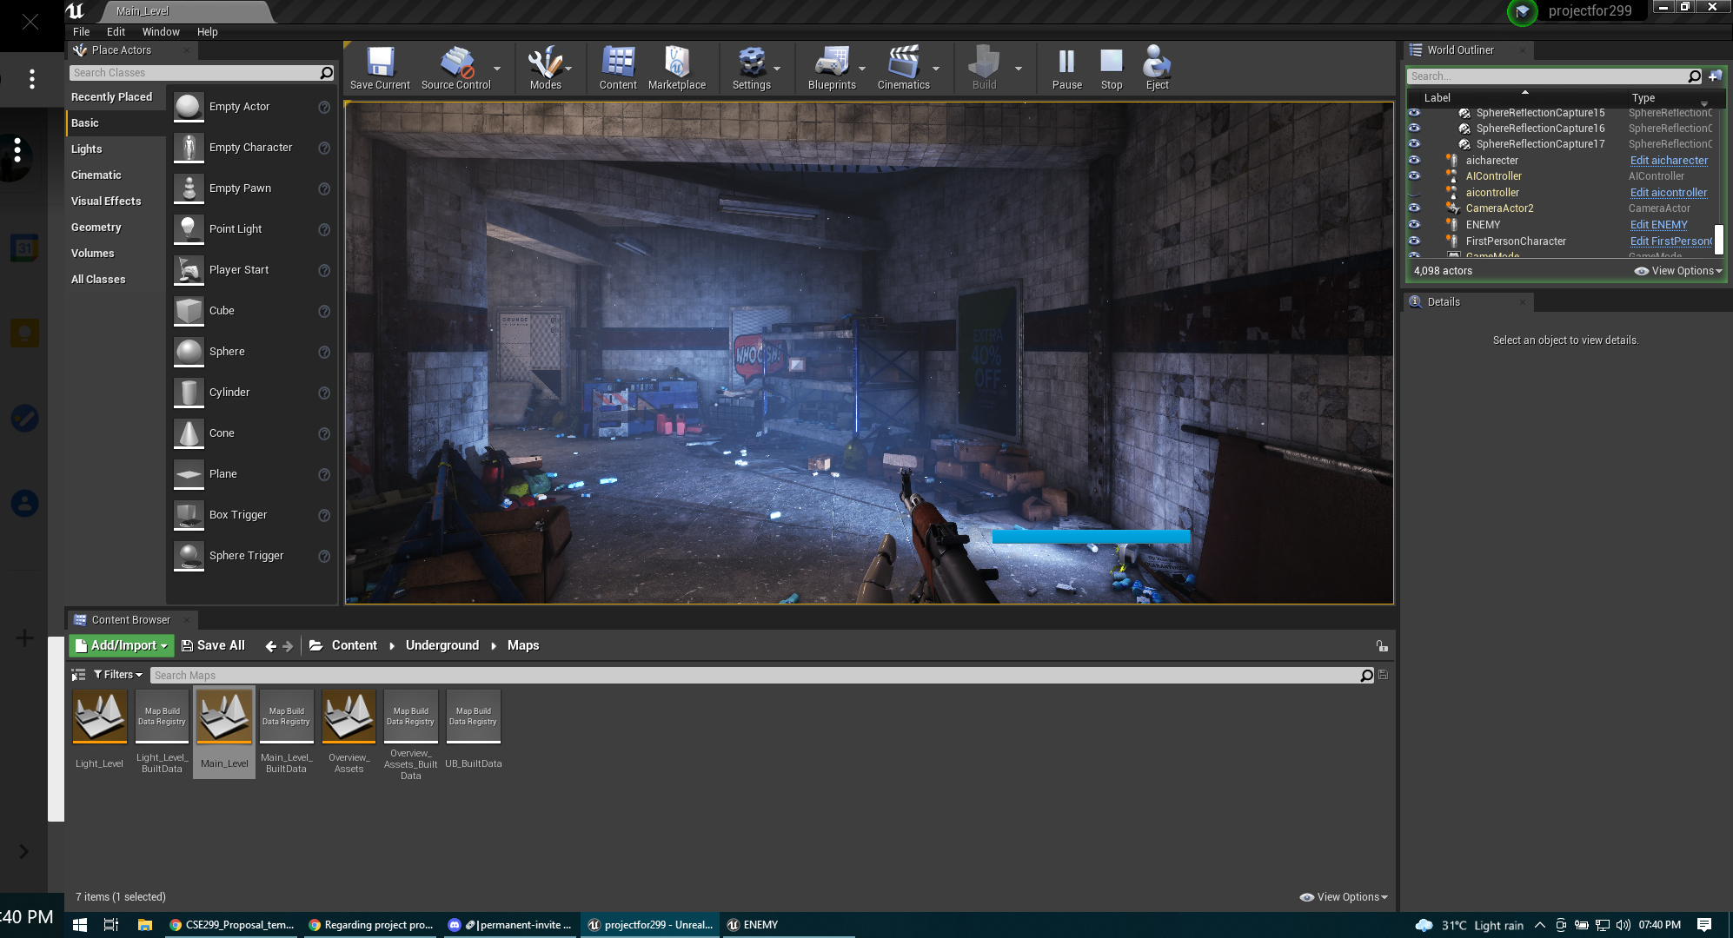
Train station level (wip)

Slide 17
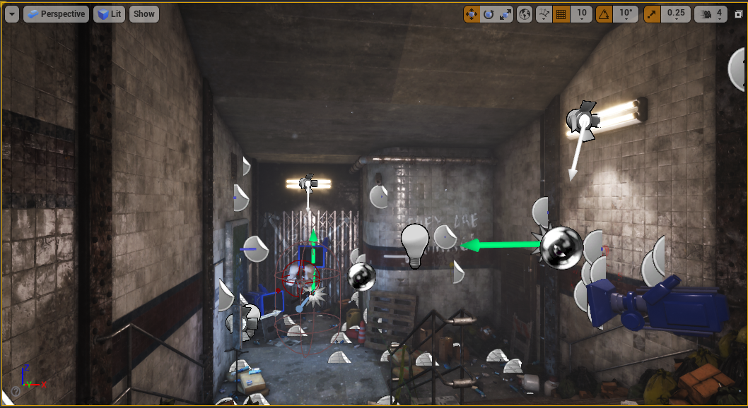
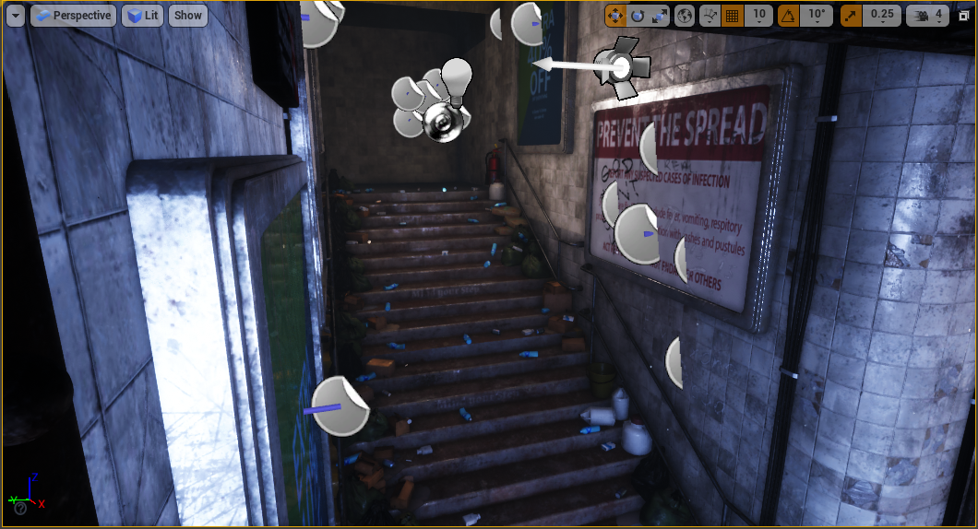
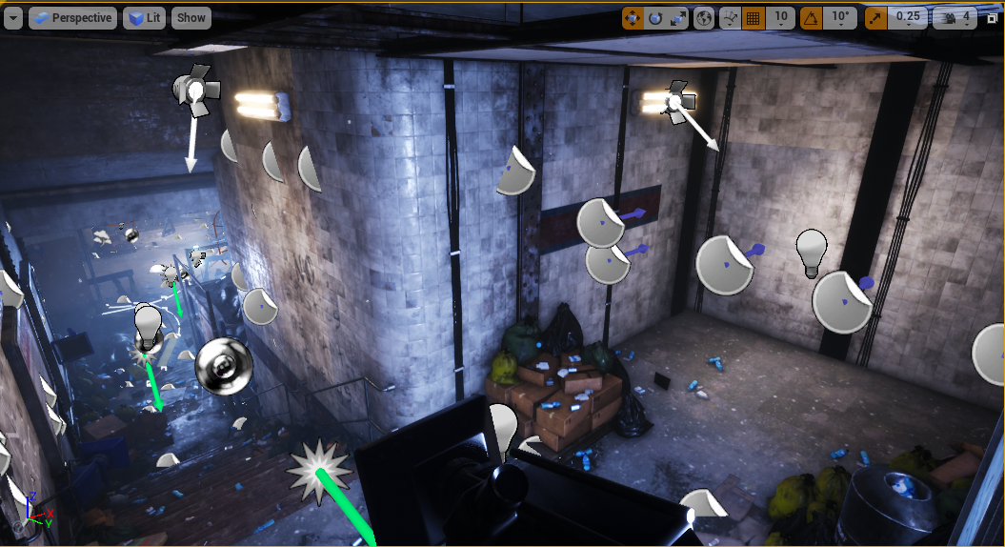
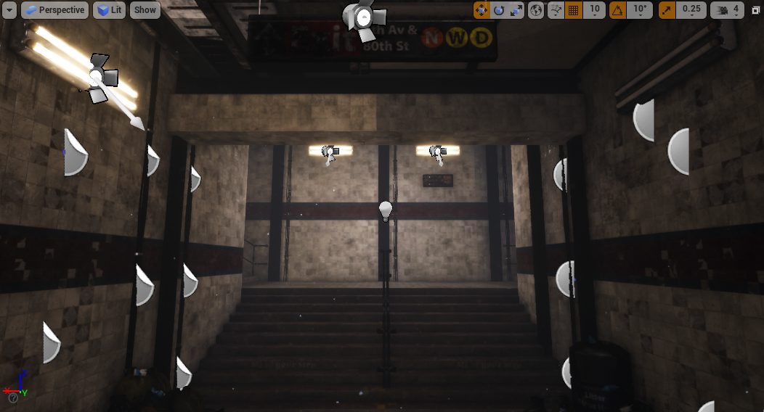
Train Station Level (Extensions made)

Slide 18
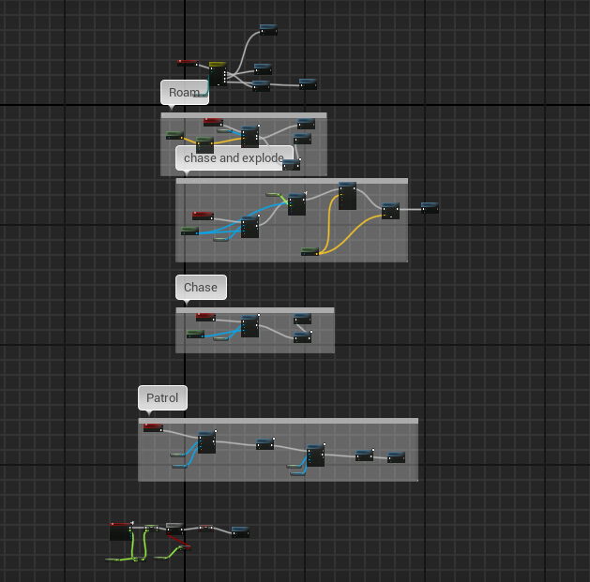
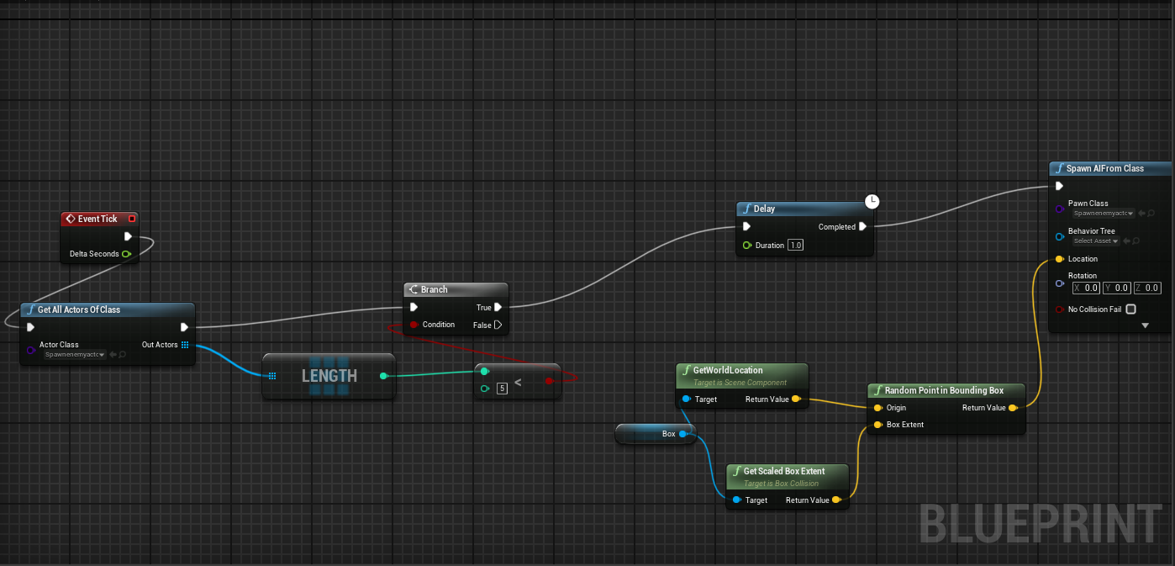
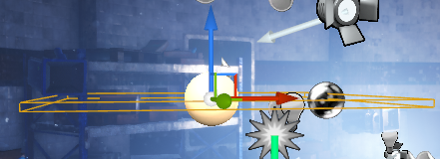
Horde system & Spawner and enemies

Slide 19
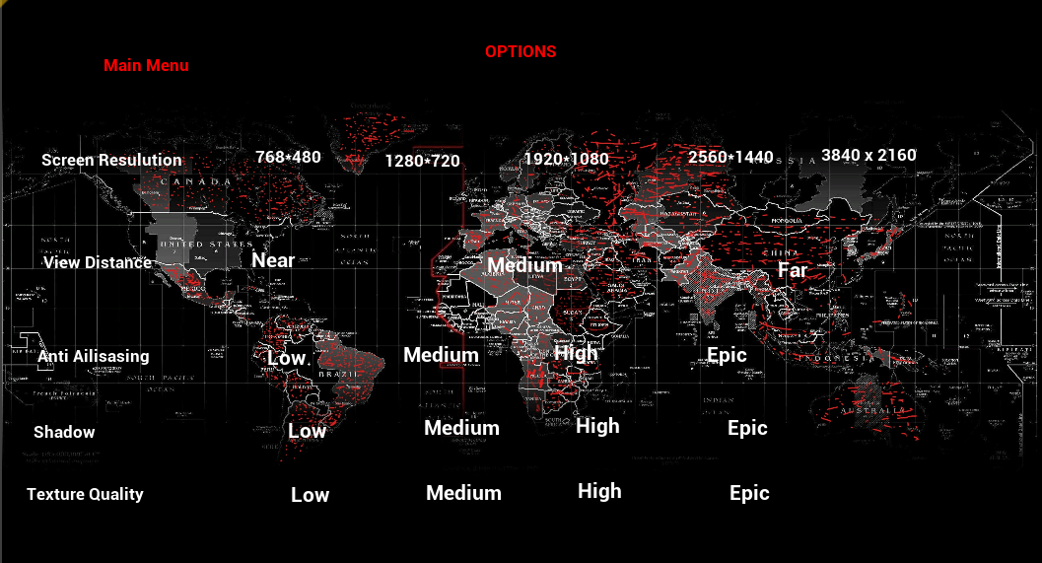
Options Menu

Slide 20
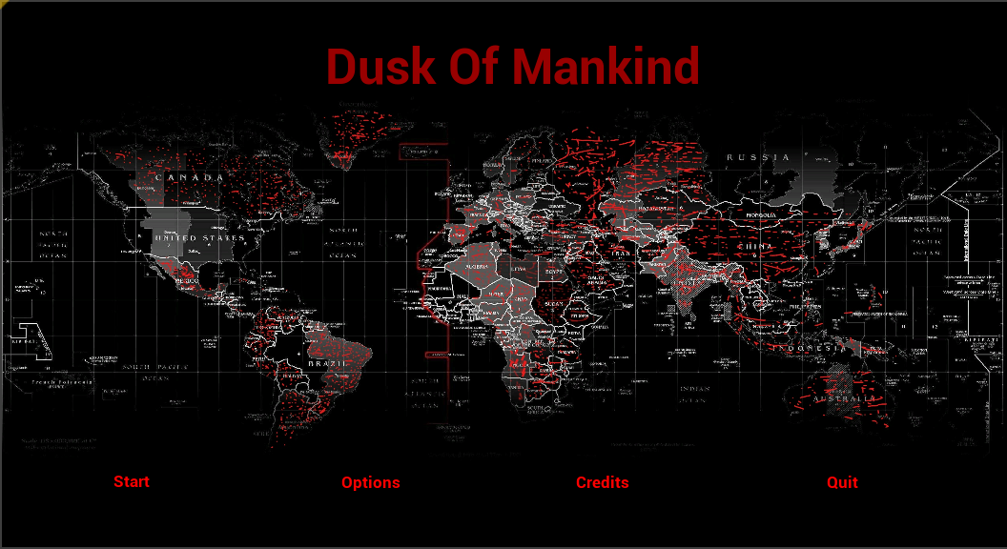
Start Menu

Slide 21
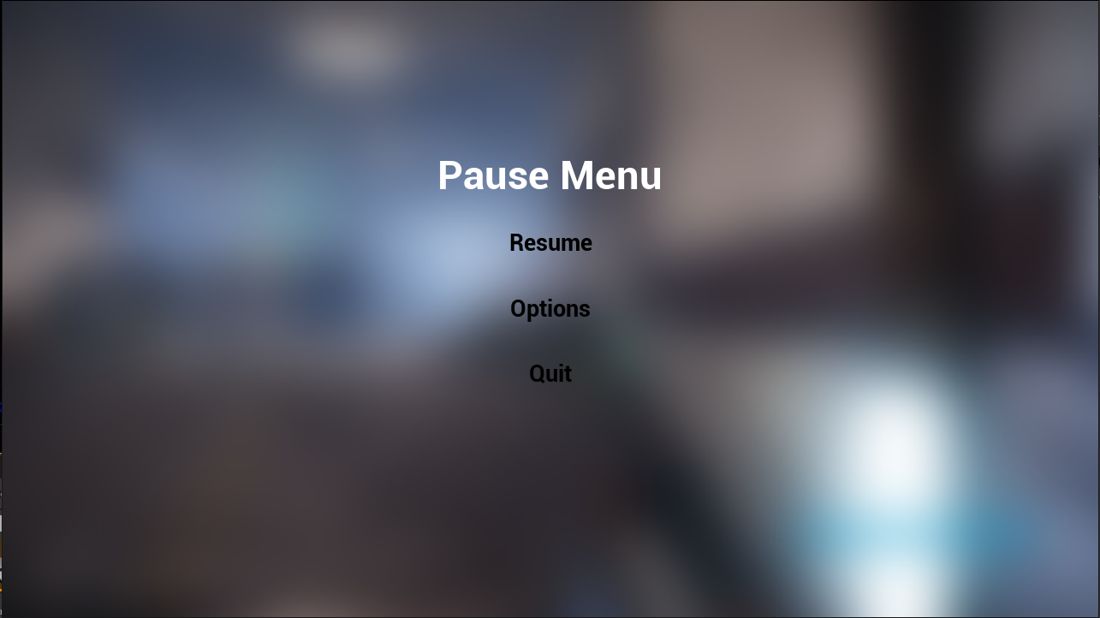
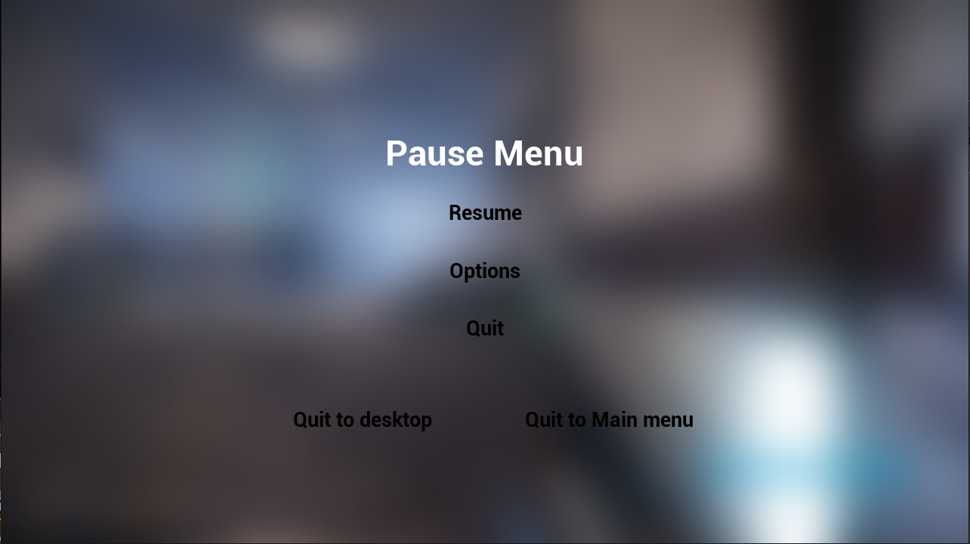
Pause Menu And Quit Menu From Pause menu

Slide 22
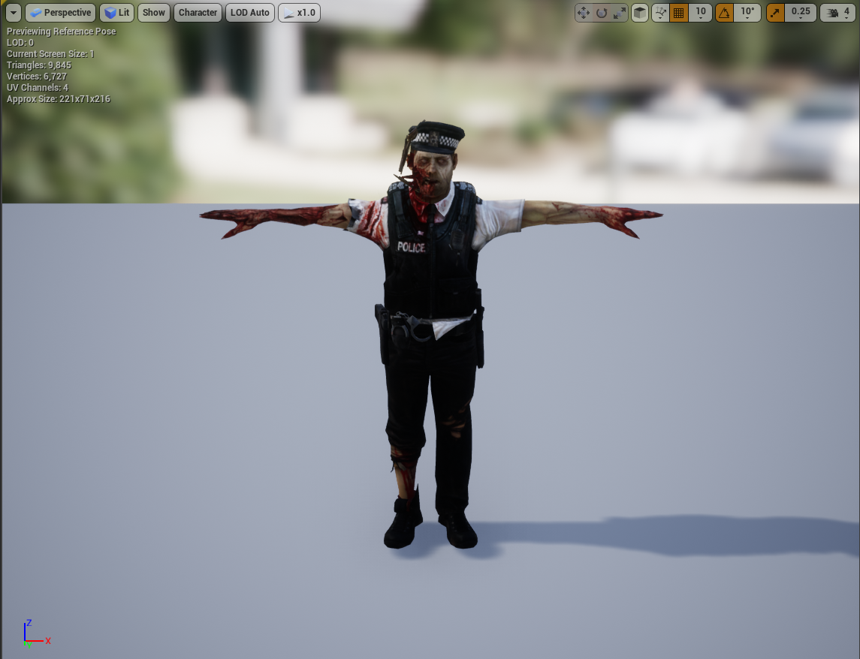
Horde enemy Skeletal Mesh For Train Station Map

Slide 23
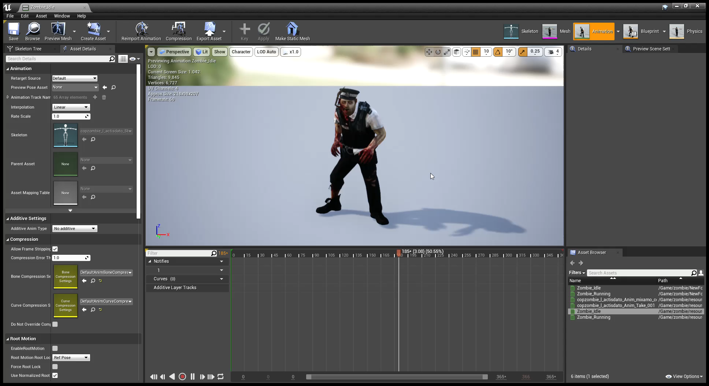
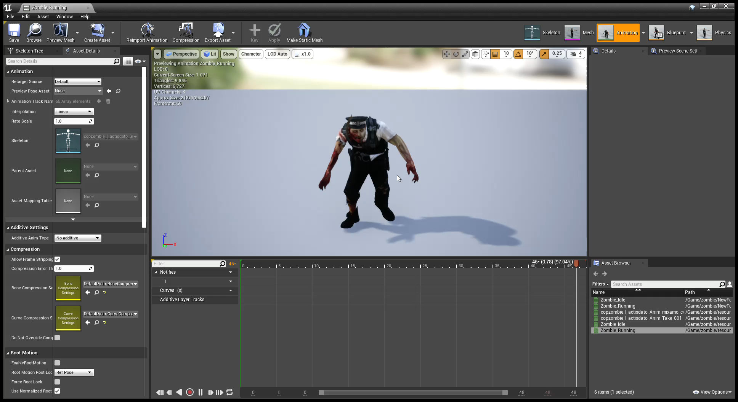
Animations for train Station Enemy

Slide 24
ACTION PLAN
Work Done
First Map
Enemy AI
Gun Models
Story
Back
story
Shoot
ing
HUD
Wave system
Enemy damage
Player damage
Protagonist character
Start screen
Death screen
Pause Menu
Enemy Placement
For the first map
Bullet tracers ,impact ,hit sound, muzzle flash
Enemy Animation
Options Menu
Wave Spawner
Work due
Scoring
System
2nd map
3rd map
Cut scenes
Enemy Placement
(cant progress until map completion)
Leader board System

Slide 25
THANK YOU
Moin Uddin huq; 1620005042
Abdullahel Kafi; 1620022042
Tanjila Islam Ritu;1811017642
Tanzila Islam; 1811027642

